Slide 1

Haskell
23rd March 2021

Slide 2
Installation

Slide 3

Installation
Haskell can be downloaded from https://www.haskell.org/platform/windows.html
Download the 64 bit Windows form

Slide 4
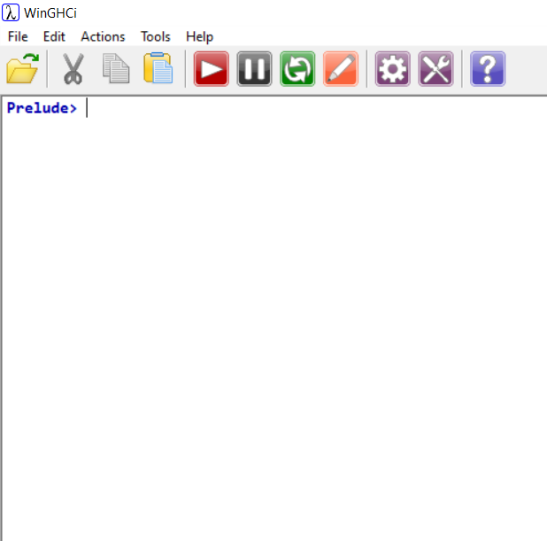
REPL Systems
There are two Haskell versions;
GHCi, the ‘MSDOS’ or ‘PowerShell’ version
WinGHCi, the ‘Windows’ version (now obsolete)
The letters stand for
G = Glasgow
H = Haskell
C = Compiler
i = Interactive

Slide 5
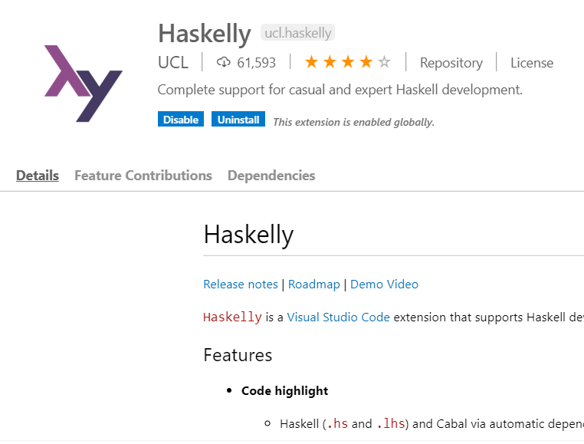
Visual Studio Code and Haskelly #1
Open Visual Studio Code
Use Ctrl+Shift+P to open quick command
Use ‘ext install’ to go to the search for extensions
Get Haskelly installed
This provides a proper editor for Haskell

Slide 6
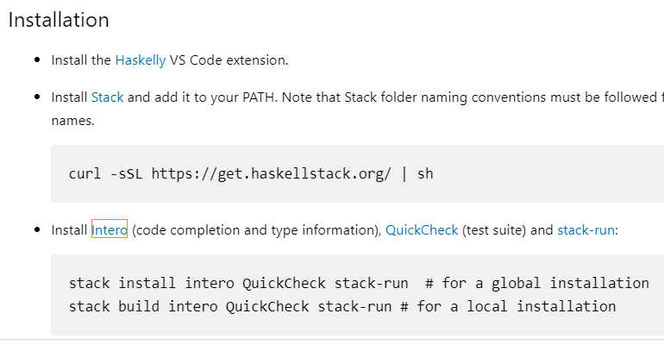
Visual Studio Code and Haskelly #2
More is required for a properly functioning Haskelly
You need to install Stack, by clicking on the link and downloading the Windows installation for the software
Using the new Stack software, go to PowerShell and run ‘stack install intero QuickCheck stack-run’

Slide 7
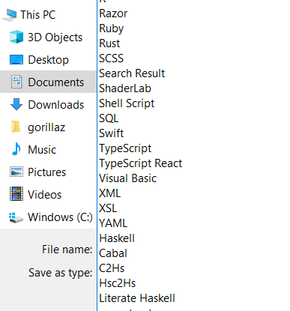
Visual Studio Code and Haskelly #3
New files are created with File - New File
Files can be saved with File - Save and File - Save As
When saving a file, possible extensions are .hs for Haskell files and .lhs for Literate Haskell files, typically Haskell files are what you want
Use the ‘Haskell’ file type - the default is a signature file (*.hsig) but the standard extension (*.hs) for a Haskell file can be added to the filename the first time it is saved

Slide 8

Hoogle
The packages available to Haskell are held on the database called Hoogle
The web address is https://hoogle.haskell.org/

Slide 9
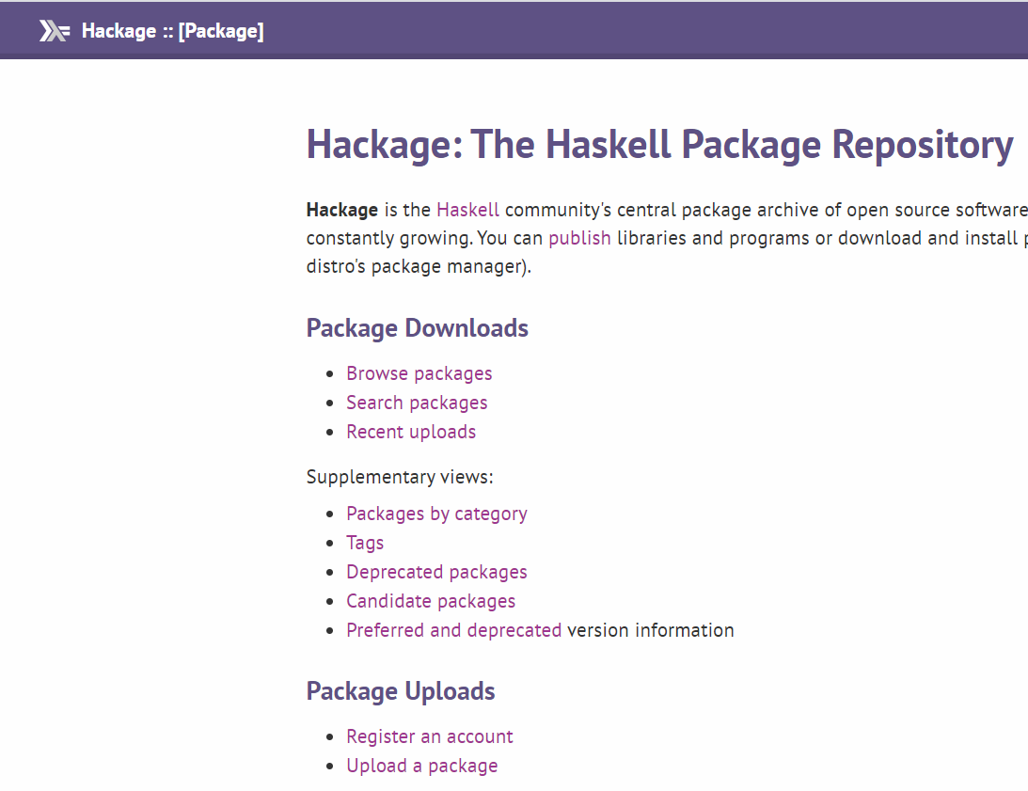
Hackage
https://wiki.haskell.org/How_to_unpack_a_tar_file_in_Windows
Hackage is another place to find packages, but only packages outside of the core
https://hackage.haskell.org/
Typing in the name of the package provides a download link, for the package as a .tar.gz tarball
A tarball can be decompressed using the ‘tar’ tool from within MinGW, using command ‘tar xzvf file.tar’

Slide 10
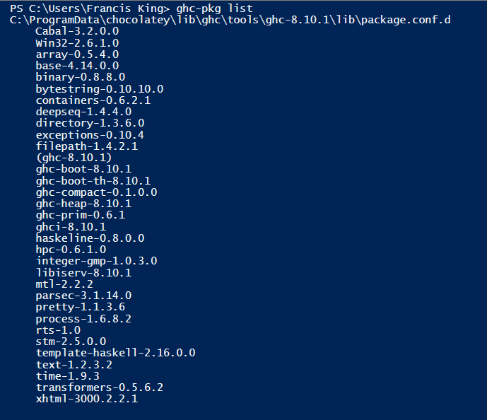
installed libraries
Using ‘ghc-pkg list’, the list of packages currently installed can be seen
Going to Hoogle, and typing in ‘array’ for example shows that the package is in fact module Data.Array
This can be loaded into a session of GHCi using ‘:m Data.Array’
To load modules, use ‘:m + FirstModule SecondModule’

Slide 11

CoCalc #1
CoCalc is a on-line version of Jupyter
Web site is CoCalc.org
There is a subscription for a better service provision
Free service has a 0.5 hours idle timeout

Slide 12
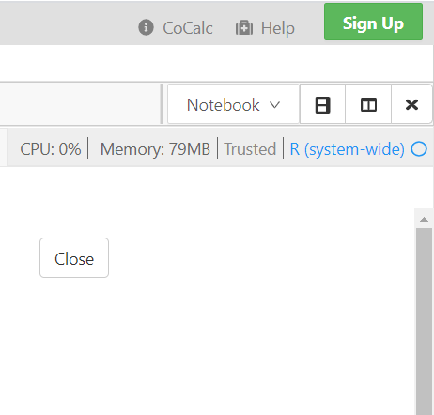
CoCalc #2
CoCalc can change the kernel by clicking the name of the kernel
This switches to the front page from which the kernel can be selected
From there you can select the kernel to use

Slide 13
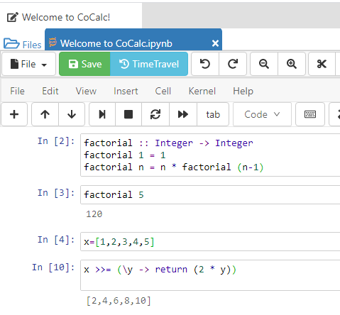
CoCalc #3
CoCalc provides a full Jupyter session
Amongst the kernels is Haskell

Slide 14
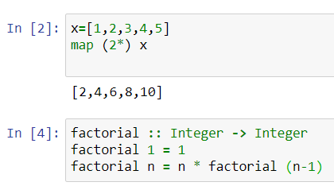
MyBinder
MyBinder is another way to run Haskell in Jupyter
The IHaskell kernel can be installed on Linux but not Windows
A Windows installation can be obtained with MyBinder
The web site is https://mybinder.org/v2/gh/gibiansky/IHaskell/master
The result is a full Jupyter instance

Slide 15
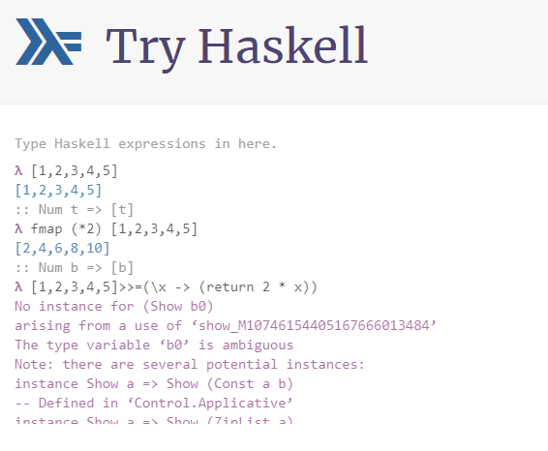
Try Haskell
The website Try Haskell, http://tryhaskell.org/, enables Haskell expressions to be tried out in the web-browser
However, there are some real limitations, such as variable bindings don’t work, and show doesn’t always work either

Slide 16
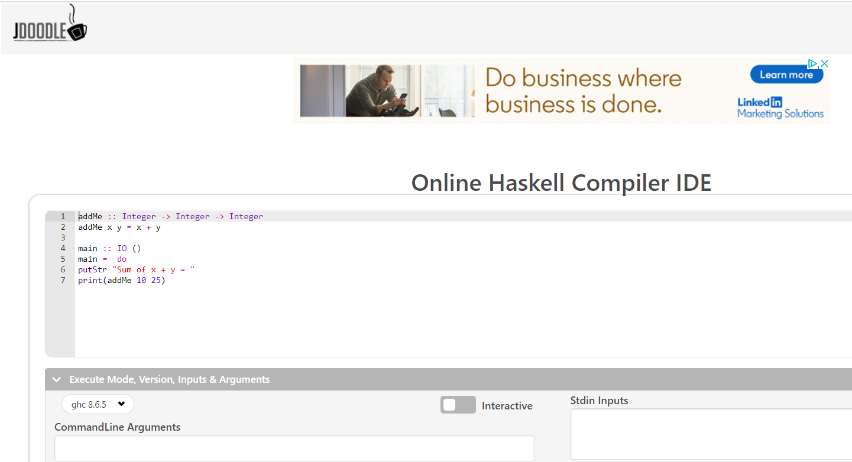
JDoodle
JDoodle also provides a Haskell compiler, but no REPL
https://www.jdoodle.com/execute-haskell-online/

Slide 17
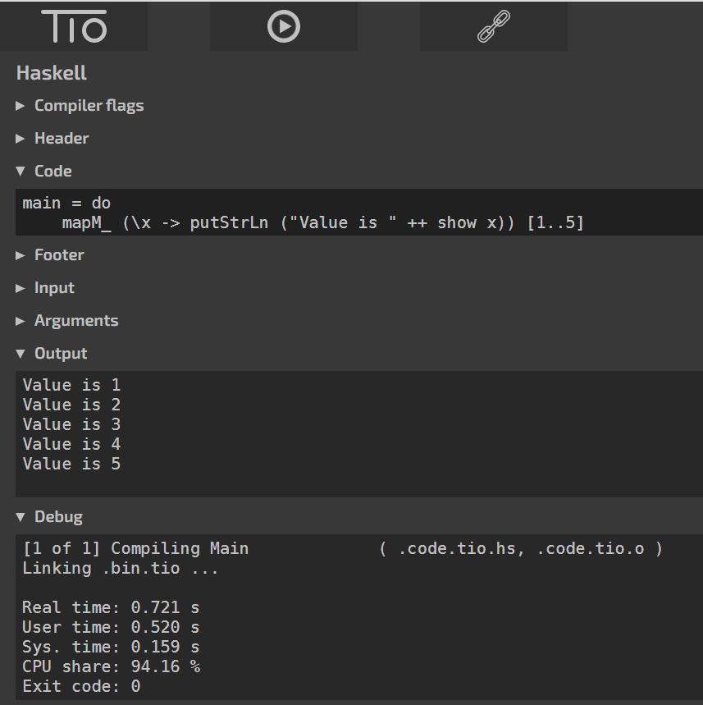
try it online
The ‘Try It Online’ website can run different languages https://tio.run/
Haskell can be chosen as the language
Then the code can be entered under ‘Code’
There is no REPL

Slide 18

Haskell Platform
The modern way to get Haskell is via the Haskell platform at https://www.haskell.org/platform/
This uses Chocolatey and Stack

Slide 19
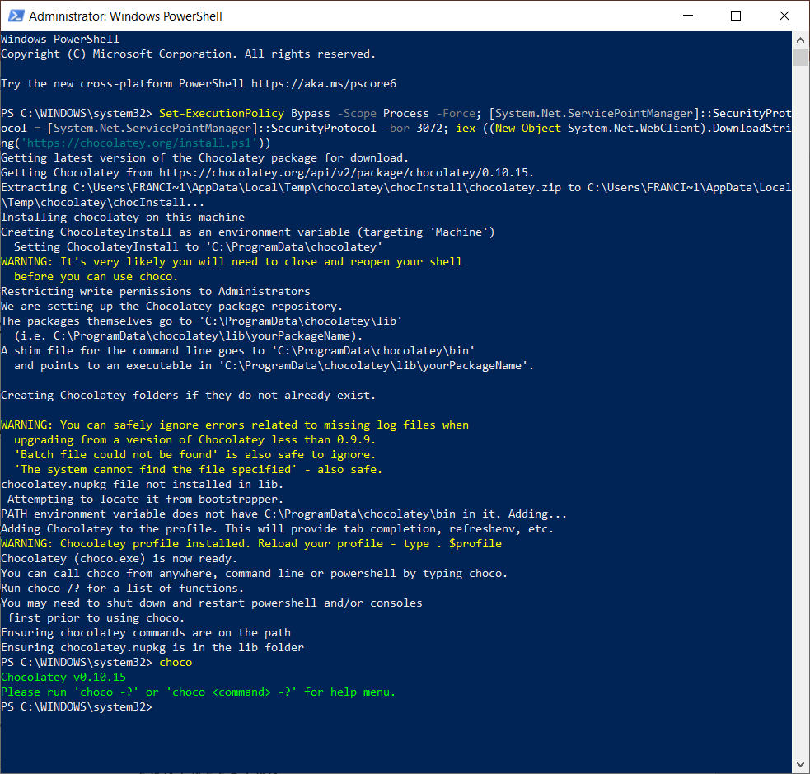
Install Chocolatey
Firstly, register for Chocolatey
Run the script provided in an Administrator PowerShell
Right click on PowerShell, select ‘Run as Administrator’
The installation should be free of errors, errors suggest not run as administrator
Run ‘choco’ at end to test for correct operation

Slide 20
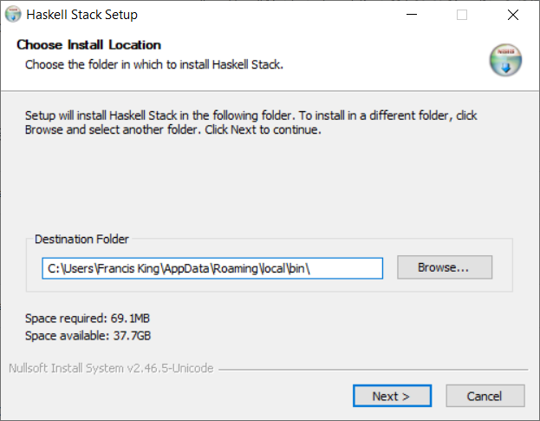
Install Stack
Stack is installed from here: https://docs.haskellstack.org/en/stable/README/
Use the Windows 64 installer

Slide 21
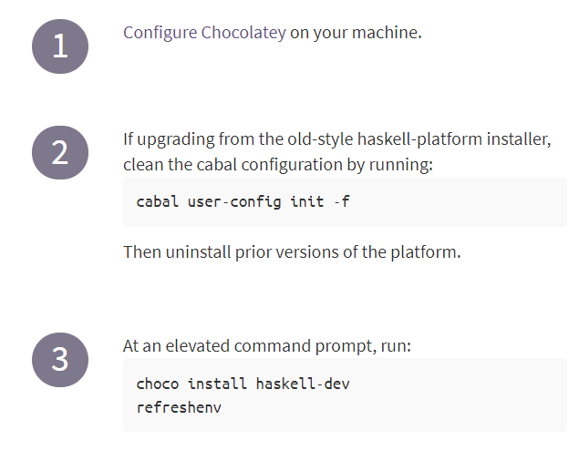
Install Haskell
From PowerShell running as administrator:
Run cabal
Run choco
The new compiler is stored here: C:\ProgramData\chocolatey\lib\ghc\tools\ghc-8.10.1\bin
If it does not work as the default compiler, it could be masked by an earlier entry in the path list

Slide 22
Using Cabal

Slide 23
Cabal #1
The correct Cabal package manager must be installed and on the path: C:\ProgramData\chocolatey\bin\cabal.exe
Cabal is a project management tool
Cabal can create a project, manage dependencies, build a project, and run a REPL
Command | Description
--help | Show cabal help
--version | Show cabal version

Slide 24
Cabal #2
Cabal is run within PowerShell, using ‘cabal command’
Cabal has two versions, v1 and v2
v1 is a limited project manager, which is compatible with the ghci REPL
v2 is a full project manager, which requires the use of cabal v2-repl
v2 is the modern version, and is the version that should be used
Command | Description
v1-command | Obsolete v1 command
v2-command | New-style v2 command
init | Create project files
v2-build | Build project
v2-repl | Start a REPL
v2-run | Build and run project

Slide 25
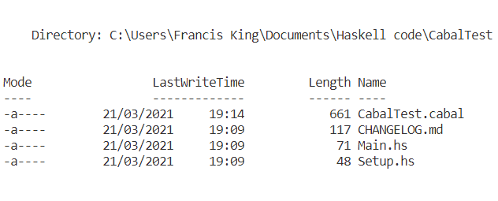
Create a Project
A new Cabal project can be built using the following procedure:
Create folder in PowerShell
Move into folder
Run ‘cabal init’
This creates a project definition file, with name ‘project.cabal’, with project given by the folder name
Also framework *.hs files for the Haskell code

Slide 26
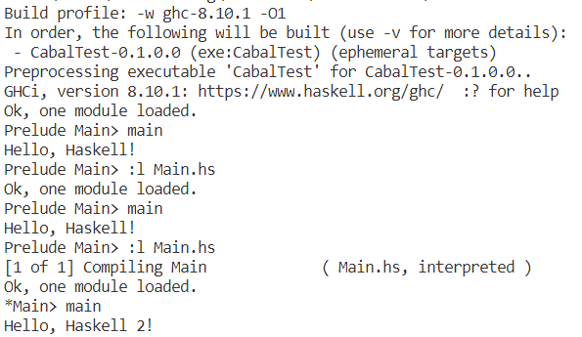
Cabal Repl
When using the v2 Cabal system, it is important to use the Cabal REPL rather than the usual ghci REPL
Cabal REPL uses the Cabal configuration file to work out where everything is - the regular ghci doesn’t do this, and cannot find the package
To start the REPL, go into the project folder, and do ‘cabal v2-repl’

Slide 27
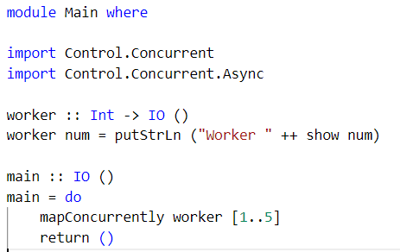
Main.hs
The Main.hs file contains the Haskell source code for the main function
A simple Hello World example is provided, which can be replaced by the real code
Once in the Cabal REPL, the usual functionality like :l and :r works, since the basis of Cabal REPL is ghci

Slide 28
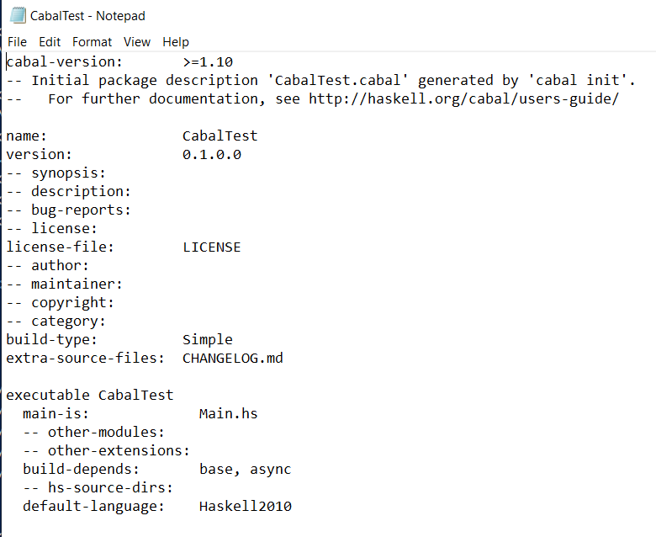
CabalTest.Cabal
http://h2.jaguarpaw.co.uk/posts/how-i-use-cabal/
The .cabal file is a text file, which can be edited in Notepad.exe or VSC
The dependencies are specified on the build-depends line, this can be overridden
The new dependencies line says ‘build-depends: comma-separated-list’
Example: build-depends: base, async
There is no need to explicitly install the dependencies, they will be automatically downloaded
Program name
Main source file
Dependencies

Slide 29
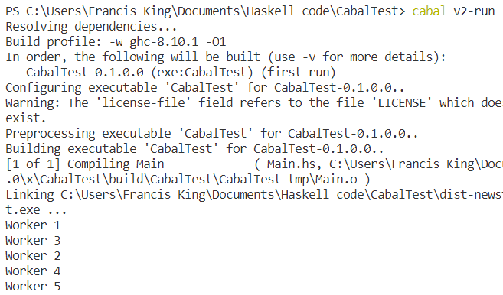
running the code
To run the code, change to the project folder, and then do ‘cabal v2-run’
This builds, links and runs the project code

Slide 30
Basic Haskell

Slide 31
Learning resources
The University of Pennsylvania has class notes / tutorial here: https://www.cis.upenn.edu/~cis194/spring13/lectures.html
There is a Haskell document: https://books.thoughtbot.com/assets/maybe-haskell.pdf

Slide 32
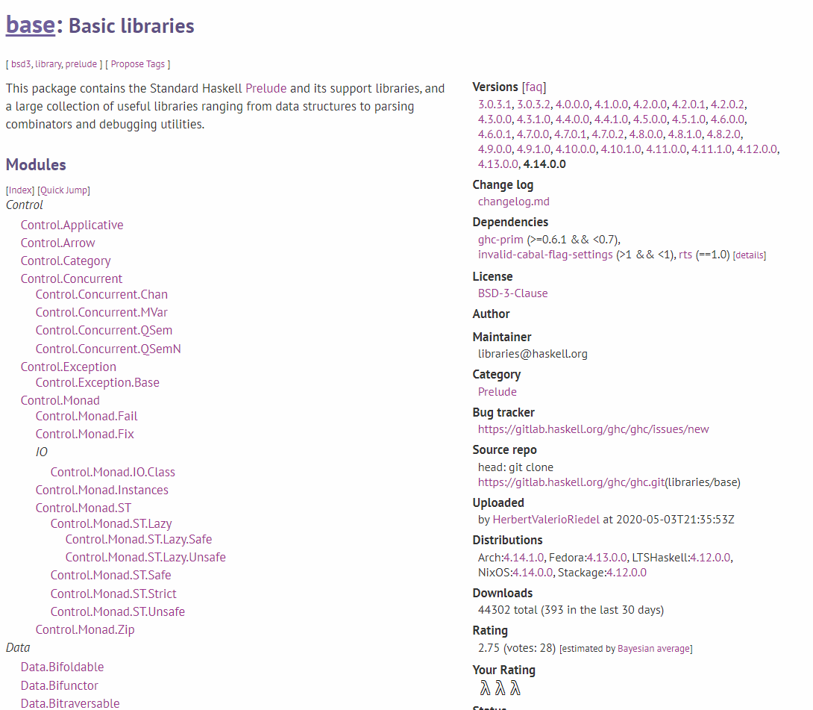
Base Libraries
The base libraries are documented here:
https://hackage.haskell.org/package/base

Slide 33
REPL Commands - loading/Saving
REPL commands are prefixed with a colon
Ctrl-S clears the REPL screen
Command | Description
:help | Show help page
:! command | Run shell command
:cd directory | Change wd to directory
:load script | Load script file
:list function | Show code of function
:edit | Edit current script file
:edit file | Edit specified script file
:r | Reload last script file
:set prompt text | Set prompt to be text

Slide 34
REPL Commands - Coding
REPL commands are prefixed with a colon
Command | Description
:help | Show help page
:t item | Show type of item
:k item | Show kind of item
:info | Show info, including classes
:{ :} | Scope brackets
:set +m | Enable multiline editing
:show bindings | Show in-scope bindings
:m module | Import module in ghci
:sprint variable | Show current variable value

Slide 35
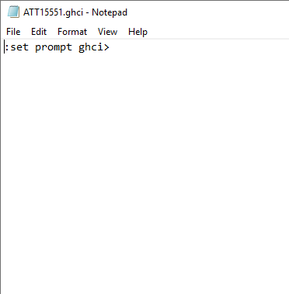
Start up File
Haskell has a startup file called .ghci
Commands entered into this file are run when Haskell REPL is started
On my computer, it is in Documents
Type :! cd to get pwd
To set the prompt to ghci >, type in :set prompt ghci>
Note, the text doesn’t have double quotes
To enable multiline editing, add :set +m

Slide 36
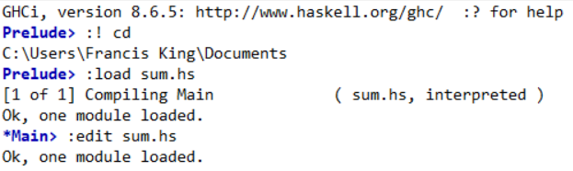
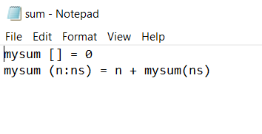
Load Scripts #1
Haskell scripts are stored in files with a .hs extension
EITHER:
Use :! cd to get pwd on Windows
Use :cd to move to the folder containing the script
Use :load to load the script file
OR:
Use File – Load (Ctrl+L)
The prompt changes from Prelude to Main

Slide 37
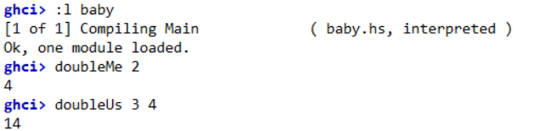
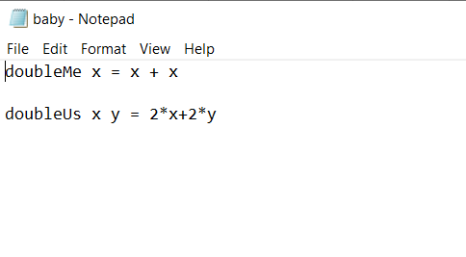
Load Scripts #2
It is necessary for the script file to have an ‘hs’ extension, but it is not necessary to specify it when loading it
In this file, two functions are defined
It doesn’t matter in what order they are defined

Slide 38
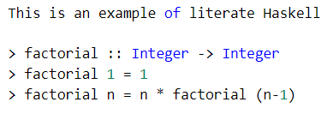
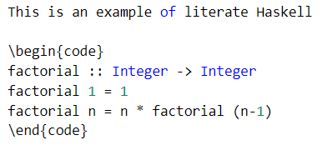
Literate Haskell
https://downloads.haskell.org/~ghc/latest/docs/html/users_guide/separate_compilation.html
Literate Haskell (*.lhs) has the opposite comments sense to standard Haskell
In standard Haskell, everything is code unless it is marked as comments (starts with -- or between {- -}
In Literate Haskell, everything is a comment unless marked as code
Code starts with >
Code is within \begin{code} \end{code} sections for Latex formatting

Slide 39
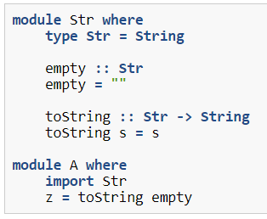
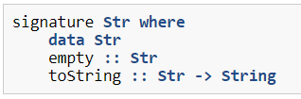
Haskell Signature
A signature file (*.hsig) in Haskell is similar to a header file in C++
The types are declared, but there is no need to provide definitions
*.hs
*.hsig

Slide 40
Error Messages
Error message | Meaning
No instance for (Num Char) arising from the literal `7' | PutStrLn expected a string, and wasn’t given one

Slide 41
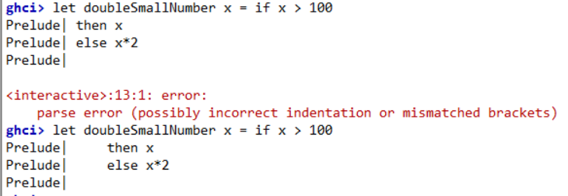
Multi-line editing
To get multi-line editing, for example a multi-line function definition, three things are necessary:
The definition must be within a code block :{ :} or :set +m
The definition must start with keyword let. This tells the REPL that a definition is coming up
Haskell is sensitive to white space, and so, because ‘let ‘ has length four characters, subsequent lines need to start with four spaces

Slide 42
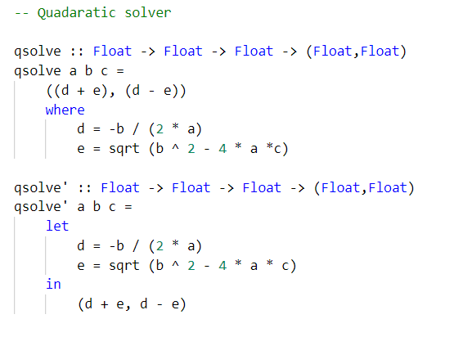
Indentation
Haskell uses indentation in a similar way to Python
Indentation by at least one space indicates that the line is within the context of the line above
If there are two lines with the same indentation this means that they in the same context
This system comes from the predecessor language to Haskell

Slide 43
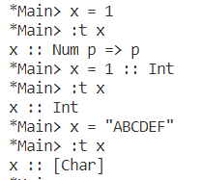
Lower and Upper Case Names
In Haskell, case has a major significance
Names which start in a lower case letter are function names and variables
Names which start in an upper case letter are Types
The apostrophe, ‘, is a valid character in a variable name

Slide 44
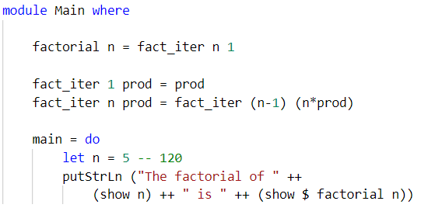
Modules #1
https://www.haskell.org/onlinereport/haskell2010/haskellch5.html
Each code file must contain at least one module
A module is defined using ‘module Name (exported list) where’
The module name must start with a capital letter but can contain a period
Subsequent code must be indented to put it within the module
If no module definition is provided then the default module is ‘module Main (main) where’

Slide 45
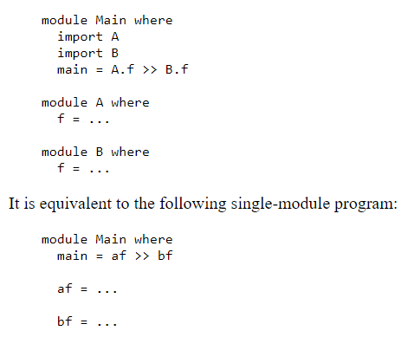
Modules #2
https://www.haskell.org/onlinereport/haskell2010/haskellch5.html
Where there is more than one module, the other module functions can be written as Module.function

Slide 46
importing modules
ghci REPL
Scripts
In ghci the command to load a module is :m module
To add a new module use :m + module
To unload a module use :m - module
In scripts the command to load a module is ‘import module’
import Data.List

Slide 47
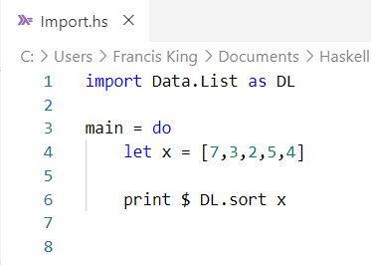
Import Qualified
https://wiki.haskell.org/Qualified_names
The ‘import module’ statement can be qualified, syntax ‘import qualified module [as alias]’
Using import dumps the new functions in the current namespace
Qualifying the imports avoids name clashes, but also requires the full length of the function to be needed, e.g. Data.List.sort
Adding ‘as alias’ renames the module as ‘alias’, e.g. DL.sort

Slide 48
Useful Modules
Module | Contains
Control.Monad | liftM, liftM2
Data.List | sort, nub
Data.Functor | $> <$
Control.Applicative | <*>
Data.Array | Array functions

Slide 49
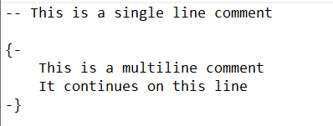
Comments
Comments in Haskell are preceded with --
Comment blocks span multiple lines, start with {- and end with -}
Some comments start with -- | or {- |, these are intended for the Haddock documentation software

Slide 50
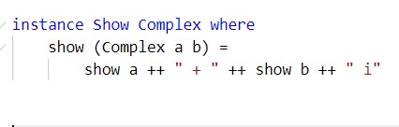
Line Continuation
Lines in Haskell can be split onto multiple lines
There is no line continuation character, however:
Best practice is to split a line after the equals sign
The second line of code should be indented at least as much as the first line, to show that it belongs to the first line

Slide 51
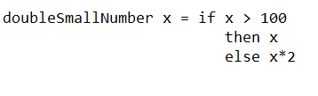
IF
‘If’ is a different thing than in most languages
In most languages, we can say ‘If this then do that.’
However, because Haskell is a functional language, all paths must return a value
Hence the ‘else’ clause is required in Haskell
Haskell programs more often use guards instead

Slide 52
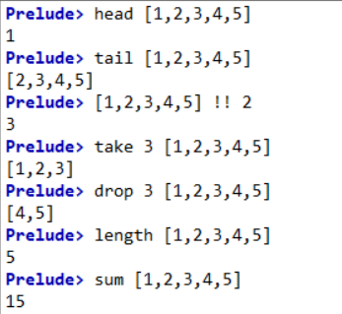
List Operations #1
The head of a list is the first element
The tail of a list is all of the other elements
The nth item is selected with !!
The first n items are selected with take
The first n items are deleted with drop
The length of the list with length
Function sum gives the sum of the list
Function product gives the product of the list

Slide 53
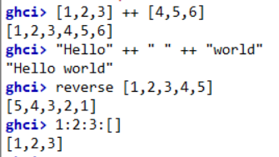
List Operations #2
++ appends two lists, adding the second list to the end
: (cons operator) appends a value to a list, adding the value to the start
[1,2,3] is shorthand for 1:2:3:[]
Because strings are just a list of characters, ++ also works on strings
The function reverse reverses a list

Slide 54
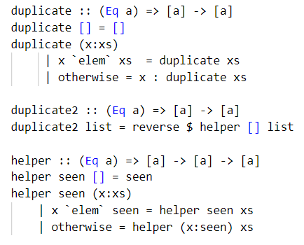
Elem and duplicate
Removing duplicates can be done using elem
If the current item is in the remaining list, ignore it, otherwise add it to the result
This retains the last value, “abcad” => “bcad”
To keep the first value, the values seen are kept separate from the remaining values to be looked at, “abcad “ =>“dcba” with the result reversed

Slide 55
List Summary
Command (on list x) | Description | Examples
head x | Returns first element of list | head [1,2,3,4,5] -> 1
tail x | Return all but first element of list | tail [1,2,3,4,5] -> [2,3,4,5]
last x | Returns last element of list | last [1,2,3,4,5] -> 5
init x | Returns all except the last element of list | init [1,2,3,4,5] -> [1,2,3,4]
reverse x | Reverses all elements of list | reverse [1,2,3,4,5] -> [5,4,3,2,1]
length x | Returns the count of the elements of list | length [1,2,3,4,5] -> 5
elem e x | Returns true if element e is within the list | elem 3 [1,2,3,4,5] -> true
sum x | Returns the sum of the elements of the list | sum [1,2,3,4,5] -> 15
prod | Returns the product of the elements of the list | product [1,2,3,4,5] -> 120
maximum x | Returns the largest element of the list | maximum [1,2,3,4,5] -> 5
minimum x | Returns the smallest element of the list | minimum [1,2,3,4,5] -> 1

Slide 56
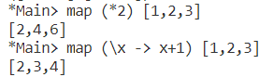
Map
Map applies a function to a list, element by element
The function can be a lambda function or a points-free expression
A limitation of map is that only one list can be handled at once

Slide 57
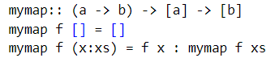
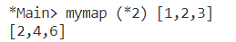
My Map
A version of map can be built using recursion
Where the list given is empty, the result is the empty list
For a non-empty list, the result is the function applied to the first element, followed by map of the function applied to the rest of the list

Slide 58
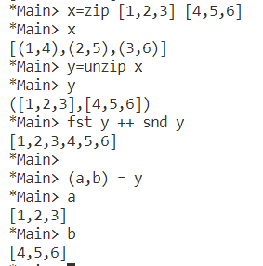
Zip
Zip takes two lists and returns a list of tuples, the ‘fst’ of the tuple is from the first list, and the ‘snd’ of the tuple is from the second list
Unzip takes the result of from zip and returns a tuple of the two lists
The two parts of the tuple can be extracted using ‘fst’ and ‘snd’, or by decomposition

Slide 59
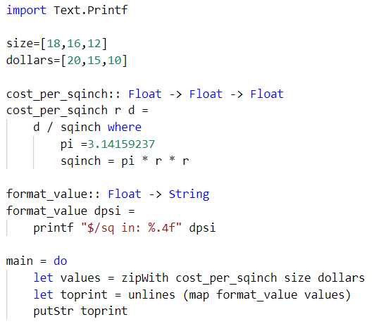
ZipWith
ZipWith works in a similar way to zip, but the pair of value are combined with an operator and put back into a list
In effect, zipWith is map but with two lists
Also, unlines takes a list of strings and concatenates them into one string, stuck together with \n

Slide 60
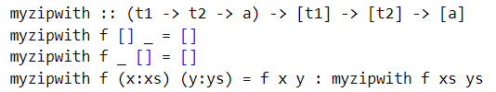
My ZipWith
A simple version of zipWith can be written as a recursion
If either list is empty then the value is []
Otherwise, the result is the function applied to the first element of each list, followed by zipWith applied to the remainder of each list

Slide 61
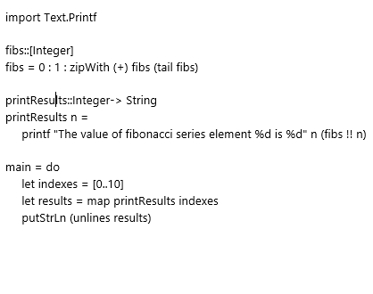
Fibonacci Series ZipWith
By using zipWith we can construct the canonical method for the Fibonacci series
The list is infinitely long but because of lazy evaluation only a finite number of terms is ever required
A pure function is created to print out the results
Main is an impure function which does the IO, printing the result

Slide 62
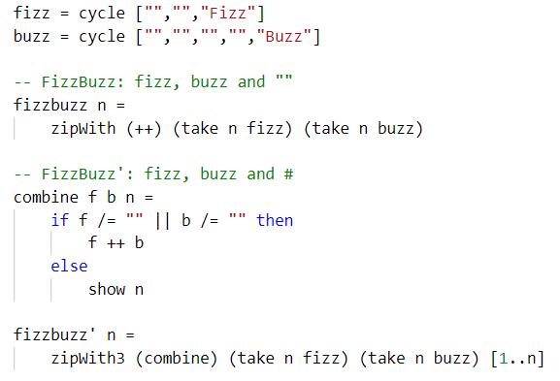
Fizz Buzz
Fizz Buzz can be calculated as an infinitely long list, taking advantage of lazy evaluation
The values of fizz and buzz are infinitely long lists, created using cycle
They can be combined using zipWith and the (++) operator
The second version shows numbers rather than “”
A bespoke ‘combine’ function is used to combine the values

Slide 63


SEQ and recursion #1
https://users.aber.ac.uk/afc/stricthaskell.html#seq
The seq function takes values ‘a’ and ‘b’, and returns ‘b’
The function forces evaluation of ‘a before evaluation of ‘b’
The function seq can be used infix, using grave accents, or alternatively the binary operator $! can be used
In the example of classic recursion, adding seq prevents stack overflow

Slide 64

SEQ and recursion #2
https://mail.haskell.org/pipermail/beginners/2010-February/003396.html
Forcing evaluation prevents expensive thunks being stored on the stack, but it still uses a thunk to store the result and the values still take stack space
Going tail recursive helps, because it uses no stack space, but still uses thunks in the calculation, which are evaluated at the end and have to be stored in memory
The best approach is tail recursion AND using seq on the accumulator to force recalculation of the sum as it goes

Slide 65


Concat
Concat is a function to flatten a list
Each application removes the outermost layer of a list
A simple recursion can convert a list to a list of lists
Concat flattens the list of lists down to a list, by sticking the internal lists end to end

Slide 66

Fold vs Map
https://stackoverflow.com/questions/5726445/how-would-you-define-map-and-filter-using-foldr-in-haskell
Map applies a function to each element of the target in turn
Therefore the output has to be the same size as the input
By contrast, fold and filter can return a different sized output
Fold takes a function, a base value and a list

Slide 67

Fold #1
The syntax is ‘fold op initial list’
There are three kinds of fold in Haskell:
foldl, folds from the left
foldl’, folds from the left
foldr, folds from the right
Both foldr and foldl compute the result by creating a recursion on the stack, hence the risk of a stack overflow
Foldl’ does the calculation as it goes, so there are no stack limitations, but it requires the module Data.List

Slide 68

Fold #2
Both the left and right fold use the same syntax, although they work very differently
foldl = result op value
foldr = value op results
When op is subract:
foldl takes the zero result and subtracts the items one after the other
foldr takes the result away from the value, one after the other

Slide 69
fold #3
foldr is usually the right version to use, but if a left fold is required foldl’ works better, is faster and more efficient

Slide 70
Fold #4
foldl
foldr
1
2
3
4
5
6
7
8
9
10

Slide 71

Tuples #1
Haskell has tuples, which as in other languages, are multiple values, separated by commas, and enclosed in parentheses
Unlike a list, a tuple can contain a mix of value types, up to four elements
However a list of tuples must have tuples of a single size and type – preventing errors that would come with a list of lists where the inner lists can be of any size

Slide 72

Tuples #2
The contents of a tuple can be obtained in a variety of ways:
First element, fst
Second element, snd
Destructuring, by providing an equal number of variables and matching off
Trying to use fst or snd on a tuple of more than four elements is an error

Slide 73

:SPRINT AND LAZINESS
Haskell is a ‘lazy’ system, whereas most systems are ‘strict’
Calculations are not done until required, which increases efficiency
The calculation is replaced with a ‘thunk’ which details the calculation without doing it
:sprint shows the current value, and thunk is represented as ‘_’
Laziness permits parallelisation of the code – the evaluation of the thunk is the calculation

Slide 74

Ranges
Ranges can be defined like lists, but with two periods to indicate a sequence
A range like [1..5] means [1,2,3,4,5] and [‘a’ .. ’z’] means “ABCDEFGHIJKLMNOPQRSTUVWXYZ”
If the first value is qualified with a comma and another value, these are the first two values, from whic the step size is deduced
If the last value is missing the end result is a lazy list, infinitely long, from which values can be taken with ‘take’

Slide 75

List Comprehensions
Haskell list comprehensions take the form of a list containing two things, separated by ‘|’
What we want to return
The values going into it
(Optionally) a list of conditions, separated by commas

Slide 76
Example
We want to find a triangle with sides length (a, b, c), where the total length is 24, and the triangle is right angle triangle

Slide 77

Types #1
Haskell has type inference
Thus, Haskell can determine what the type of a value or a function is, without the programmer having to tell it – although it is considered to be good practice to explicitly give a type signature
The type operator is ::
The type of any item is given by the type operator, :t
[ ] means a list, ‘a’ and ‘b’ means any type, but not necessarily the same type

Slide 78
Types #2
Num
Type | Contains
Num | Real, Complex + - * negate abs
Integral | Integer (unlimited precision) Int (64 bits) Remainder Integer division
Fractional | Float (low precision) Double (high precision) Rational (ratio of integers) Normal division
Real
Complex
Integral
Fractional
Int
Float
Integer
Double
Rational

Slide 79
Function Signature
Function | Function Signature | Interpretation
add1 x = x + 1 | Num a => a -> a | Function takes one value and returns one value, where that value is of type Num (general number)
add1b x = x + 1.0 | Fractional a => a -> a | Function takes one value and returns one value, where that value is of type Fractional (floating point)
add2 x y = x + y | Int a => a -> a -> a | Function takes two values and returns one value, where those values are of type Int (integral number)
map | (a -> b) -> [a] -> [b] | The first value is a function itself, taking one list and returning one list

Slide 80

Average, Data types
https://stackoverflow.com/questions/2376981/haskell-types-frustrating-a-simple-average-function
For genericLength
realToFrac :: (Real a, Fractional b) => a -> b
genericLength :: Num i => [a] -> i
sum :: (Foldable t, Num a) => t a -> a
(/) :: Fractional a => a -> a -> a
The limiting factor is the division, of type Fractional -> Fractional
So, both sides need to be coerced to be of type Fractional
The usual length function returns Int, which won’t work
realToFrac is required as there is no automatic coercion

Slide 81
Data vs Type Constructor
https://stackoverflow.com/questions/18204308/haskell-type-vs-data-constructor?rq=1
Data and type constructors are linked with the ‘data’ keyword
Type constructor is to the left of the equals sign
Data constructor(s) is/are to the right of the equals sign
Like a constructor in C++
The name of the type constructor can be equal to the name of the data constructor
They are in different namespaces
Use type constructor name where a type is required
Use data constructor name where data is required
data type constructor = data constructor(s)

Slide 82

Data Constructor #1
The data constructor can be one or more values, separated by guards (‘|’)
Each value is a function which takes zero or more arguments
In this example, there are three data constructors, Red, Green and Blue which take no arguments, and are used as values for comparison purposes etc.
In this scheme, the type Colour is like an enumerated value in another language

Slide 83

Data Constructor #2
A data constructor can also take arguments, such as in the creation of a complex type
Here there is one type constructor, ‘Complex’ and one data constructor ‘Complex Float Float’
They don’t have to have the same name, although often they do

Slide 84
Data Constructor #3
It is possible to create multiple data constructors, separated by guards
The type can only consist of one of the data constructors at a time
In this example, the type constructor is Shape, and there are two data constructors:
Circle
Rectangle

Slide 85

Data Constructor #4
As a concrete example, Maybe is defined using the data keyword
It is a type which can be one of two things:
Just a
None
The definitions of Maybe can be seen with :info Maybe

Slide 86

Data Constructor #5
One problem with the above approach is that the values in the data type above don’t have a name or identifier
Circle Float Float Float, for example, doesn’t say what is the centre x, what is the centre y, and what is the radius
An alternative syntax is data Name = Name { member1 :: Type1, member 2 :: Type2 …. }, where the member names are lower case, Type is capitalised
Haskell automatically creates access functions member1, member2

Slide 87
Instance Show #1
https://stackoverflow.com/questions/47269879/how-to-show-a-user-defined-data-type-in-haskell
The easiest way of adding a Show instance to a new data constructor is to add ‘deriving (Show)’ to the end
This automatically supplies default values, with the instances, the mechanisms, specified in the comma separated list
The instance Show with capital letter, method show with lowercase letter
The default Show is enough for most purposes,

Slide 88

Instance Show #2
Defining a Show instance yourself, the syntax is:
‘instance Show type-name where’,
followed by each ‘show data-name’, one data-name per line
where the data constructor take arguments, the data-name and arguments are enclosed in ( )
The contents of the instance on the second and subsequent lines must be indented
We use show to print the values
They are simple values, so are OK

Slide 89

Instance Show #3
Another way of doing this is to declare a function which takes the data type, and returns a string
This can then be declared as being the show method

Slide 90

Instance Show #4

Slide 91

Instance Show
https://stackoverflow.com/questions/4418017/new-instance-declaration-for-show
A full instance of Show has syntax ‘instance Show Name where \n show (Name element1 element2…) =‘
A simpler instance is created using ‘deriving (Show)’ which makes a default instance of Show - simply showing the values

Slide 92

Example

Slide 93

Example
http://progopedia.com/example/factorial/118/#:~:text=Factorial%20in%20Haskell&text=definition%20of%20factorial%20function%2C%20which,given%20explicitly%20to%20avoid%20ambiguity.&text=printf%20command%20is%20the%20same%20as%20in%20C%2B%2B.
The module keyword allows for the definition of the Main module
The function ‘printf’ is not available by default, but can be loaded using import, in this case Text.Printf (note imported mo is uppercase, function is lower case)
The factorial is defined as Integer -> Integer so as to permit large values

Slide 94

Type Alias
A type alias is declared with ‘type newname = declaration’
The name has to have a capital first letter, as with all types

Slide 95


Modules
https://www.haskell.org/tutorial/modules.html
Modules can be created using a first line ‘module Modulename [(export_list)] where’
The imported module name must start with a capital letter
If the export list, a comma separated list of names, is omitted then all names are exported
When a code file that needs a module is loaded, the code is also loaded

Slide 96

Type Conversion, To/From Strings
Numerical types can be converted to / from strings
Strings can be converted to numerical using ‘read’
read value :: type
Numerical types can be converted to strings using ‘show’
show value

Slide 97

Number Conversion
An integer number can be converted to a float using the function from fromIntegral for all except Integer
Syntax is fromIntegral(Value)::NewType
For integers to other types, the function fromInteger is provided
Conversion from float can be done with the function ‘round’

Slide 98

Constraints
In the type results, there is often a => operator
This is the constraint operator
It says the values have to be of this type
Asking about [1,2,3,4] we get ‘Num a => [a]’
[a] means a list of type a
Num a => means a must be of type Num, a number

Slide 99

Polymorphism
There are two kinds of type in Haskell -
Concrete types like Int, Integer, Float and String where the first letter is a capital letter
Variable types like a, b, p where the first (only) letter is a lowercase letter
Where the type is variable, any type matching the constraints can be used

Slide 100

Functions #1
Functions are called without parentheses, unlike most languages
Functions have the highest priority
So, taking the built-in function ‘succ’ which returns the value plus one
succ 9 returns 10
succ 9 * 10 returns 100, since succ binds tighter to 9 than *
succ (9*10) returns 91
By using backticks, we can insert a function, taking the value before and the value after it

Slide 101

Functions #2
Function names can include the apostrophe, although it designates a character
Function names cannot start with a capital letter

Slide 102


Function types
Every function also has type inference
The type is declared just before the function itself, with the function name succeeded by a double colon and the type signature
It is good practice to supply a signature except
The type signature is like this:
functionname :: Int -> Int -> Int
The last type is the return type

Slide 103


Curried Functions #1
Functions can receive parameters in two ways:
All at one time in a tuple, (a, b, c)
One by one, a b c
Although the function can see all of the parameters, the function binds closest to the leftmost parameter
f a b is really (f a) b
Hence String -> Int -> Int, really means String -> (Int -> Int), a function takes a string and returns a function of type int -> int

Slide 104
Curried functions #2
When a function is curried, the function binds closer to the item which follows it and which is separated by a space
The new curried function is then applied to the next item, and so on
An optimising compiler may well optimise it back to a single function
Int -> Int -> Int
myfunction x y
Int -> (Int -> Int)
myfunction_x y

Slide 105


Function Composition #1
It is possible to use one function on another function
The output type of the second function must match the input type of the first function, and is applied right to left
In maths f(g(x)) is written $\left(f∘g\right)\left(x\right)$, where $∘$ is called the Composite Operator
In Haskell, this is written (f . g)

Slide 106

Function Composition #2
There are two ways of doing function composition
func x = f . g x
func x = (f . g) x
What we want to do is combine f and g, and then apply this to x
However, function application is greedy and in the first case f is combined with g x instead, an error
Point free syntax, func = f .g, avoids this problem

Slide 107

Partial Function
A partial function is one where the function only works for some values
This factorial function doesn’t work for negative values, and is partial
fac 0 = 1
fac n = n * fac (n-1)
This head function doesn’t work for an empty list, and is partial
head(x:_)=x
Partial functions can problems later and are a problem

Slide 108

Lambdas
The Lambda operator is ‘\’
Lambdas are defined by using the lambda operator, the variable, and then -> followed by the formula
To apply it to a value or variable, or as the first parameter of map, put the lambda in parentheses

Slide 109

Point Free
Because of currying, we can write a lambda function without a variable to act upon
So (\x -> x*2) is the same as (*2)
The same point free approach can be applied with function composition, where the functions are applied right to left as usual

Slide 110

Pattern matching
Haskell has pattern matching – similar to multiple dispatch
When there are multiple function definitions, these are searched in order until a matching function is found
The most general case always comes last – if it comes first, it will always match, which is the wrong thing to do

Slide 111

Defining SUM
Sum is defined as two things:
The empty list case
How to convert a list to a smaller list
In the first example, however ‘sum’ is defined twice. The second definition overrides the first. There is a missing case because of the redefinition, hence the error message
In the second and third examples, the { ; } form means that only one definition is made

Slide 112

Defining Prod
Prod is defined as two things:
The empty list case
How to convert a list to a smaller list
In the first example, however ‘prod’ is defined twice. The second definition overrides the first. There is a missing case because of the redefinition, hence the error message
In the second and third examples, the { ; } form means that only one definition is made

Slide 113


Guards
Guards are an alternative way of writing a function
There is no equals sign, instead there are a sequence of indented conditions, prefixed with ’|’
Syntax is ‘| condition = result’
A common error is to add an equals sign to the function at the start, the equals sign goes with each condition
The default condition is ‘otherwise’

Slide 114


Case
Case follows a similar pattern to guards, except it uses an equals sign
The syntax is ‘case variable of indented list pattern -> result’
Unlike with guards, the function does use an equals sign
In the example, myhead [] cannot return [], it must error or return some value. This is because of the function signature

Slide 115


Where
The where clauses enables additional calculations to a pattern match or similar, binding a variable before the pattern match
Indentation is key to allow Haskell to know what is going on
Where has to align with the items to which it is attached

Slide 116

Let
https://stackoverflow.com/questions/8274650/in-haskell-when-do-we-use-in-with-let
There are many kinds of let statement and let expression
Let statement, let variable = expression (used only in do-block, and then only for pure expressions)
Let expression, let variable = expression in expression
Used in list comprehension, let variable = expression, to extend another

Slide 117


Let in and Where
Where
Let In
Where can be used to define small functions in a previously defined larger function
Let can be used to define small functions within a later define larger function

Slide 118

Quick Sort
Quick sort, qsort, can equally be written as a recursion
We take the first element of the list, stick smaller values at the front and larger values at the end; ++ combines the lists
These other values, unsorted, are themselves passed through qsort
The original value is put in list brackets, since we are trying to output a list
We do the definition over multiple lines with :{ :}

Slide 119

Quick Reverse Sort
Quick reverse sort, qrsort, can equally be written as a recursion
We take the first element of the list, stick larger values at the front and smaller values at the end; ++ combines the lists
These other values, unsorted, are themselves passed through qrsort
The original value is put in list brackets, since we are trying to output a list
We do the definition over multiple lines with :{ :}

Slide 120


Maybe #1
Where there is a possibility of a function returning a value, such as an Int, it can be declared as ‘Maybe Int’
To match this declaration, we need to return ‘Just value’ or ‘Nothing’
The use of Maybe wraps the value and forces the user to deal any errors
Case can be used to extract the value by pattern matching against ‘Just value’ and ‘Nothing’

Slide 121

maybe #2
When Maybe is used in a type signature, it has to be accompanied with a type:
Maybe Int
Maybe String
Maybe Float
Maybe a is a polymorphic type, but which may struggle to resolve the type signature

Slide 122


Maybe #3
Maybe a can be helpful with functions such as head and tail, the base versions error on empty lists

Slide 123

Pure and impure Functions
Haskell makes a distinction between Pure and Impure functions
A pure function is one where there are no side effects, e.g. \x -> x^2
An impure function is one where there are side effects, e.g. printing to screen, reading from keyboard
Values from an impure function are bound to a variable with <- operator
This keeps the pure and impure areas separate

Slide 124
IO Functions
Command | Syntax | Description
putStr | putStr string | Prints the string to the console
putStrLn | putStrLn string | Prints the string to the console, adds new line
print | print item | Prints item to the console, if it can be created to a string by ‘show’ function ‘Print x’ is ‘putStrLn (Show x)’
getLine | string <- getLine | Get text from keyboard, return it as an IO string
<- | string <- IO string | Unbox and bind IO string to string
return | return (item) | Wraps item in an IO box and returns this value. Not C++, does not end function

Slide 125

Show, Print, putStrLN
Print and putStrLn both use the IO Monad, and are generally used within a ‘do’ block
Show by contrast, just converts the data to a string
The best way to print data to the screen is ‘print’

Slide 126


Main .. Do #1
A Haskell program starts with the function ‘main’
This is set equal to ‘do’, to start a do block
Underneath this is an indented sequence of statements, which can include impure I/O actions
Do blocks are the only valid location for multiple I/O actions
However, we can have multiple do blocks, including main
The REPL is also a valid location

Slide 127

Main .. Do #2
https://www.haskell.org/tutorial/io.html
The main function must return an IO value, and the signature must say this
The last value in the function is the return value, and so the last value must be an IO value
If a string is printed, the result is effectively void, here IO ( )
A formatting function can be provided, either returning a String or an IO action, depending on whether the intention is to create a pure or impure section

Slide 128
Do Notation #1
https://en.wikibooks.org/wiki/Haskell/do_notation
http://www.haskellforall.com/2014/10/how-to-desugar-haskell-code.html
The ‘do’ notation is syntactical sugar
Within a do block, the >> operator, which means ‘then’, is implied and is not written
The >>= operator, the bind operator, is written <-
putStr “text” >> becomes do putStr “text”
do variable <- getLine is the sugared version of getLine >>= (\ variable -> next_instruction)

Slide 129

Do Notation #2
https://en.wikibooks.org/wiki/Haskell/do_notation
At the end of an IO function, if the last function returns ‘void’ then the signature is IO ( )
If the last function returns a value like an integer, then return value yields IO type
Both with and without ‘do’ the same return syntax is used
The returned value is an IO action which can extracted using ‘bind’, <-

Slide 130


Do Notation #3
https://en.wikibooks.org/wiki/Haskell/do_notation
Do Notation
Equivalent using >> (then operator)

Slide 131

Do Notation #4
https://en.wikibooks.org/wiki/Haskell/do_notation
The >> operator is the same as the >>= operator, but with the lambda variable being the wildcard _

Slide 132


Do Notation #5
https://en.wikibooks.org/wiki/Haskell/do_notation
Do Notation
Equivalent using >>= (bind operator)

Slide 133


Compile Haskell Code
To compile Haskell code using WinGHCi, load the script file with :l or File - Load
Tools - GHC Compiler with run make on the main function in the currently loaded script file
Finally, the red arrow button will start execution at main

Slide 134
De-sugaring of Code #1
https://stackoverflow.com/questions/8019670/desugaring-do-notation-for-monads
Haskell can show the de-sugared code, using the Haskell compiler
ghc -c source.hs -ddump-ds
This produces the dump of the core language, which is complex and had to read
A simpler output is produced by adding -dsuppress-all, this is much more readable
Flag | Meaning
-ddump-ds | Dump de-sugger output
-dsuppress-all | Suppress everything
-ddump-simpl | Dump simplifier output

Slide 135


De-sugaring of Code #2
Haskell
Dump

Slide 136
Type Class
A type class is not object orientation, as it might be in C++
Instead it is closer to a struct
Defined with keyword ‘data typeclass = definition’
You define the fields that make it up and the derived methods that it implements
Methods are added with deriving (comma separated list)
Method | Description
Eq | Items can be compared
Ord | Items can be ordered
Show | We can convert data to a string
Read | Converts strings to values of this type
Bounded | Has minimum and maximum (minBound, maxBound)
Enum | Has predecessors and successors (succ, pred)

Slide 137

Newtype
https://www.youtube.com/watch?v=mlTO510zO78
The ‘newtype’ keyword can be used to alias an existing type to a new name
Syntax newtype new_type = new_type old_type
This means that parameters can be given specific names, making it harder to get the order wrong
In this example, the values of assoc and target could be put in the wrong way around
After, newtype this error would be blocked by the compiler

Slide 138
type and newtype
Type and newtype work in a similar way
Type provides an alias for an existing data type, where the new alias is completely interchangeable with the old type
Newtype provides an alias for an existing type, but the new alias is separate from the old type

Slide 139


Instance
Usually, the methods are derived from existing stock methods
It is possible to define new methods, using the instance keyword
The syntax is ‘instance method type_class where’ followed by definitions, so for Eq:
“Red” == “Red” = True
_ == _ = False

Slide 140

type Constructors #1
A type constructor is different to a type
A type is something like Int, Float, Double, String and is a type
A type constructor is something that creates a type, such as [ ] to create a list and Maybe to create a Maybe value
[ ] takes an Int and creates a [Int]
Maybe takes an Int and creates a Maybe Int

Slide 141

type Constructors #2
:k gives the kind of an item
Using :k, Int is of kind ‘*’, a concrete type
Maybe is of kind ‘* -> *’ meaning that it takes a concrete type, e.g. Int, and turns it into another concrete type, Maybe Int

Slide 142
Type Constructors #3
A type constructor, in essence, puts a box around the original type
So a list type constructor, [ ], puts a list around the sequence of Int, Float, Double, String
Likewise, a type constructor, Maybe, puts a Maybe around the Int, Float, Double, String
Int
Int
[ ]
Maybe
Int
Int
[ ]
Maybe

Slide 143


Files And Streams
To open a file, you need to use openFile, which requires the import of System.IO
openFile takes filename and a mode, and returns a handle with <-
When reading, hGetContents returns a list of strings, one per line, with <-
Finally the file is closed with hclose handle

Slide 144

Haskell Speed #1
https://www.quora.com/How-fast-is-Haskell
http://flyingfrogblog.blogspot.com/2010/08/parallel-generic-quicksort-in-haskell.html

Slide 145

Haskell Speed #2
http://augustss.blogspot.com/2007/08/quicksort-in-haskell-quicksort-is.html

Slide 146
Sort
sort
sortBy
import Data.List -- sort
This function sorts simple orderable lists
Simple orderable lists include lists of numbers and lists of text
import Data.List -- sortBy
import Data.Ord (comparing) -- ordering
This function sorts based upon a sorting function, for example (comparing snd) for the second item in a structure

Slide 147

Sortby - values summing to 63, maximal product

Slide 148

Recursive Fibonacci example
A fast way of running a Fibonacci calculation is to swap the values over
If the first two values are a, b with b >= a, then the new values are b, (a+b)
The final step is where n is 1
The recursion is done in the style of tail recursion

Slide 149


Recursive Sequence Example
The desired sequence is 2, -4, 6, -8, 10…
So $S_{n}=−2n . {\left(−1\right)}^{n}$
The initial value, n = 1, is 2
The sequence $n→n+1=−n/(n−1)$

Slide 150
Functors

Slide 151
Types and Type Constructors
http://learnyouahaskell.com/making-our-own-types-and-typeclasses#the-functor-typeclass
Types
Type Constructor
Types are concrete things
Int, String, Char are types
Also [Int], [String], [Char] are also types
Also, Maybe Int and Maybe String are also types
:k Maybe Int gives *, a single concrete types
Type constructors are the things which make concrete types from other concrete types
[ ] and Maybe are type constructors
:k Maybe gives * -> *, a type constructor, concrete type -> concrete type, e.g. int -> maybe int

Slide 152

Functors #1
Functors are type constructors which we can map functions over
In fact, map is a functor where the type constructor is [ ] and only for that type constructor map is the same as fmap
A functor takes an item:
where a type constructor has been applied,
removes the type constructor,
applies a function,
reapplies the type constructor
fmap (a -> b) -> f a -> f b
where: f is not a function, it is a functor like [ ] or Maybe

Slide 153


Functors #2
Here are some other functors
map, functor is [ ]
Maybe, functor is Maybe
IO actions
When an IO action is done, it creates an impure function, and as such returns an IO action, accessed with <-
IO being a functor means that we can fmap a function over an IO action
fmap gets the value from the IO action, applies the function, and uses return() to rebuild the IO action

Slide 154

Functors #3
Another use of fmap to apply a ‘read’ conversion to getLine
The result is again an IO action, which is bound to a name with <-
In this case we used the infix fmap operator <$>

Slide 155

<$>
The function fmap is a prefix operator
It can be made into an infix operator in two ways:
Use grave accents
By using the <$> operator

Slide 156

($>) and (<$)
In module Data.Functor there are two operators, $> and <$
Module Data.Functor is imported into the REPL with :m Data.Functor
Data in the functor is replaced with the new value

Slide 157

Mapping a Function over a Function #1
Mapping a function over another function, using fmap, creates another function
This is because fmap (+2) on a list creates a functor, and fmap (*3) on the results creates another functor
The operations are applied right-to-left
Hence <$> composites functions together

Slide 158

Mapping a Function over a Function #2
In this case, both fmap, <$>, and the applicative map, <*>, are used
The first statement turns [1,2,3] into [*1,*2,*3]
The second statement applies [*1,*2,*3] to [1,2,3], leading to a list [1,2,3,2,4,6,3,6,9]
The list is printed out by mapping show over the list, creating a list of strings, unlines to build a single string, and putStrLn to print it

Slide 159

Mapping a Function over a Function #2
In the last line, the $ operator can be replaced by the . operator
Unlines takes a [String] and returns a String, and putStrLn takes a String and returns a IO ( )
Hence the operator . can be used for function composition

Slide 160
Map variants #1
There are many map variants, because each one does something distinctly different
Map type | Signature | Description
map | (a -> b) -> [a] -> [b] | Apply function (a -> b) to [a] to produce [b]
fmap | (a -> b) -> f a -> f b | Apply function (a -> b) to functor a to produce functor b
mapM | (a -> m b) -> t a -> m (t b) | Apply function (type -> monad) to transversable a to produce monad of transversable b
mapM_ | (a -> m b) -> t a -> m ( ) | Apply function (type -> monad) to transversable a to produce an effect, and empty outcome. Used to do effects, not a calculation

Slide 161

Map variants #2
In this example, the function print_fib is mapped over the range [1..n]
Because the function is of type value -> monad, here the IO monad, we have to use mapM
The function mapM_ was selected since the print effect was the objective

Slide 162

Applicative Functors #1
https://www.tutorialspoint.com/haskell/haskell_functor.htm
An applicative functor takes ‘map’ one stage further
Function map applies a function to a list, a list being a functor because we can map over it
Function fmap applies a function to any functor, not just list
Applicative functors take two functors, extracts the function from the first and applies to the second, operator <*>
In this example, f is a applicative functor and lst is a regular functor

Slide 163
Applicative Functors #2
The functions map, fmap and applicative map are basically equivalent
Expressions are read left-to-right
If the function is contained within a functor (lhs) then used an applicative functor (<*>), otherwise use fmap or map
Map (`map`) can be used when the target functor is a list, otherwise use fmap (<$>)
(++) <$> Just “Johntra” <*> Just “volta”
(++) is a plain function, whereas Just is not a list. Hence use fmap. This creates a new applicative functor
The next mapping operation has the applicative functor on the lhs, and a functor on the right, hence use the applicative functor operator

Slide 164

Applicative Functors #3
http://learnyouahaskell.com/functors-applicative-functors-and-monoids
The function <*> is left associative, so A <*> B <*> C is the same as (A <*> B) <*> C
The function ‘pure’ is like return in that it builds a functor, or a monad from a monad and is more general
The function ‘pure’ applied to *2 puts an applicative around the *2
Hence pure (+) <*> Just 3 <*> Just 5 is Just (+3) <*> Just 5, or Just 8

Slide 165

Applicative Functors #4
An example in Learn You a Haskell For Great Good, let f = (+) <$> (*2) <*> (+10) [p.310]
This applies (*2) and separately (+10) and then adds the results together
f = fmap (*5) (+3) creates a function which in turn adds 3 and multiplies by five
So f 8 = 5 * (8 + 3) = 5 * 11 = 55
Hence in the original example, f = 2 * x + (10 + x); x=3, f=19

Slide 166

Applicative Functors #5
In this case, the function is cut down.
The (+) operator takes two operands, the first is (*2) on the first value and the second is the raw value

Slide 167

Applicative functors #6
(++) <$> Just “Johntra” <*> Just “volta”
The calculation is done left-to-right, with (++) mapped over Just “Johntra” to create Just “Johntra”++, a function within the functor Just
<*> extracts the function on the left side and fmaps it over the right side
This is then extracted and mapped over “volta”, which remains within Just, just as mapping over a list returns a list
Hence Just “Johntravolta”

Slide 168
Monoids, Monads and Associative Functions
http://adit.io/posts/2013-04-17-functors,_applicatives,_and_monads_in_pictures.html

Slide 169
Monoids
A monoid is a combination of:
An object
An action on the object
If the action on the object obeys certain laws, then the object/action pair is a monoid
A monoid has the following laws:
Associativity of the action
An identity (unit) object for the action
Object
Action
Monoid

Slide 170
Commutative and Associative
Commutative
Associative
A binary operator is commutative when the order of the operands doesn’t matter
That is A op B is equal to B op A
Addition and multiplication are commutative
1 + 2 = 2 + 1; 1 * 2 = 2 * 1
Division and subtraction are not commutative
1 – 2 <> 2 – 1; 1 / 2 <> 2 / 1
A binary operator is associative when in an equation like A op B op C, we can group the terms in two ways, but the result is the same:
(A op B) op C
A op (B op C)
Addition and multiplication are associative
(1+2)+3 = 1+(2+3)
(1*2)*3 = 1* (2*3)

Slide 171
Monoids #1
An example of a monoid is a clock face
The clock face is the object
Advancing the hour hand is the action
The action is defined by the action, hour = (hour + value) % 12
The unit function is value of 12 hrs, because advancing the hand by 12 hrs takes you back to where you started
Advancing the hour hand is clearly associative
12
11
1
10
2
9
+
3
8
4
7
5
6

Slide 172
Monoids #2
The major advantage of a monoid is that it is composable
Because it has the same entry and exit types they can be stuck together like Lego blocks
Functional languages like F# create chains of such functions
12
11
1
10
Unit
2
9
3
8
4
7
5
6

Slide 173

Monoids #3
In Haskell, Monoids need to define three things for lists:
mempty (the identity operator)
mappend (link two monoids together), also ‘combine’ in Scala
mconcat (compress down to one value)
List is a Monoid, and has:
mempty, null value
mappend, ++
mconcat, list to value

Slide 174


Monoids #4
https://blog.softwaremill.com/monoid-in-the-category-of-endofunctors-b85bab43587b
The append/combine function must be associative
$\left(a ×b\right) ×c=a ×(b ×c)$
In fact, the combine function is called ‘multiplication’ in Category Theory
Some examples of monoids with these properties:
String
Int
List
Example | Combine | Empty
String | concatenate | “”
Int | + | 0
List | ++ | [ ]

Slide 175

Monoid Lists
Lists are Monoids, and provide the three operators required
mempty is the equivalent of the Lisp null
mappend combines the two lists using ++
mconcat combines the list entries together
Works for strings, as the effect is ++
Doesn’t work for numbers, as the outcome can’t be shown

Slide 176

<> Operator
The <> operator is the Monoid function mappend
For lists, it is also equivalent to the list append operator ++
The difference is that mappend, being a function, is a prefix function, whereas ++ and <> are infix operators

Slide 177

Monoids and Folds
Foldr and foldl must return the same result if the operator and the data form a monoid
If they don’t form a monoid, because the operator is not associative, the foldl and foldr might return different results
The identity of the monoid is the initial value
The operator of the monoid if the fold operator
$$fold \left(+\right) 0 x$$
Monoid operator
Monoid identity
Monoid object

Slide 178
Monads
https://medium.com/real-world-fsharp/understanding-monads-db30eeadf2bf
A Monad is a collection of three things:
A way to unit the data, to amplify and encapsulate the data
A way to map the data, to work with the data in the Monad without exposing it
A way to bind the data, to combine two Monads without exposing the internal data
In F#, the sequence is a Monad
The data is encapsulated as a sequence
The data can be computed via list comprehension
Sequences can be processed using tools like Seq.map, Seq.Iter, Seq.sum, Seq.filter
Sequences can be combined

Slide 179

Monads
https://www.youtube.com/watch?v=IBB7JpbClo8&list=PLe7Ei6viL6jGp1Rfu0dil1JH1SHk9bgDV&index=17

Slide 180

Bind, >>=
The main function is Monad
Monad m => m a -> (a -> m b) -> m b
The bind operator strips away the Monad revealing the value, but you must add the Monad back at the end
Maybe is a Monad:
Just 1 >>= (\x -> Just x) returns Just 1, where a is 1, m is Just, b is 1
Nothing >> (\x -> Just x) returns Nothing
The return type of >>= must be a Monad

Slide 181

Maybe ADD, With Bind
In this example, we combine a Monad, mx with a value y
The bind operator strips the Monad away to provide x, which we can combine with y
But we have to add the Monad back to make the type correct

Slide 182

MONADD
We can extend this bind operator to more than one variable
Here, we pass two Monads, one containing variable x and one containing variable y
We use the bind operator twice, one to strip away the Monad of x, and a second time to strip away the Monad of y
We use return to put the Monad back onto the result

Slide 183

LiftM
To process data inside a monad, we can use bind and return to access the contents
Bind lowers the monad to its values
Return returns to the monad level
Using liftM from Control.Monad, we can alternatively raise the function to the monad level
It is usually called using infix back ticks

Slide 184

Liftm2
We can take additional monads and lift functions with more operands to use the data from them
These are liftMn, where n=2, 3, 4, 5
The infix notation doesn’t work so well here, the infix version must be curried

Slide 185

Do
The do notation is another, more concise, version of the bind operator
We can replace the code
m >>= (\x -> …)
With the do sequence, and the operator x <- m
They are equivalent

Slide 186

Do MONADD
Now, we can rewrite the previous code for ‘Monadd’ using the do notation
Finally, we return the value of x+y, and return puts the Monad back

Slide 187

Haskell Maybe Monad #1
https://www.youtube.com/watch?v=t1e8gqXLbsU
Haskell has a ‘Maybe’ type, which is either ‘Nothing’ or ‘Just’ a value
Maybe is a Monad
It has two features:
return, returns the value
(a -> Maybe a)
>>= (bind operator), returns the results of applying a function if we succeed
(Maybe a -> (a ->Maybe b) -> Maybe b)

Slide 188

Haskell Maybe Monad #2
https://www.youtube.com/watch?v=ZhuHCtR3xq8
A uniform framework for doing work
Enable side effects in a pure program, otherwise you couldn’t write useful code in Haskell
F# is not a pure programming language, but it’s still a good idea
Explicit in side effects
Maybe may fail = side effect
Polymorphism, could take sequence of effects and run them one after the other

Slide 189

Either Monad
https://www.schoolofhaskell.com/school/starting-with-haskell/basics-of-haskell/10_Error_Handling
The Either Monad allows us return either a value or an error code, just as the Maybe Monad allows us to return a value or Nothing
Just is the equivalent of Right (success)
Nothing is the equivalent of Left (failure)
The type signature is Either LeftType RightType

Slide 190

State Monad #1
https://stackoverflow.com/questions/24577066/one-more-time-can-i-have-an-example-of-state-monad-that-does-what-i-want
The State monad is required to properly handle state in a Haskell program
The module Control.Monad.Trans. State is required
The basic idea is a Monad which contains data, just like a list or Just
The difference that here the data is in fact a function, which takes an old state to a new state plus a return value
s -> (a, s)
s is the state
a is the return value

Slide 191

State Monad #2
http://brandon.si/code/the-state-monad-a-tutorial-for-the-confused/
The monad is created by applying the ‘state’ type constructor to the function
However, the signature is in fact ‘State’
The internal function is run using runState
runState has two parameters
The state action to be run
The initial state

Slide 192


Main Loop
It is bad practice to create a main loop by recursively calling main
Instead, main calls a new function, mainloop

Slide 193

Reader Monad
http://learnyouahaskell.com/for-a-few-monads-more
The reader monad is located in Control.Monad.Instances
The reader monad is the same thing as the applicative functor operator

Slide 194

Writer Monad
The Writer monad is located in Control.Monad.Writer
The type signature is Writer (upper case), but the constructor is writer (lower case)
The Writer monad allows values to be stored in a monad together with a text
To execute the Writer monad, runWriter is required.

Slide 195
Mathematically

Slide 196

Mathematically #1
https://en.wikipedia.org/wiki/Functor_(functional_programming)
A functor, f, is defined for a transformation, fmap, between categories (objects)
The functor, f, is defined by the pair of object and map function
Example, a list and the map (*2)
The functor is a class in the same way as Eq and Ord, but defined for functors rather than types

Slide 197
Mathematically #2
https://en.wikipedia.org/wiki/Functor_(functional_programming)
The functor f could be a list and a function, so for example:
a is integer
b is string
The f a is a list of integers, f b is a list of strings
(a -> b) is the conversion function

Slide 198
Mathematically #3
A functor mathematically maps from one category of types & functions to another.
Functors that map from a category to itself is an endofunctor
Haskell has one such category ‘f’ in each map or fmap, so all functors are endofunctors
In the case of lists and a map, the functor maps from list to list, an endofunctor

Slide 199


Mathematically #4
Monads take the Monoid and extend it a little bit for Endofunctors
Monoids provide two transformations:
$μ:T ⨂{T →} T$
$η:I →T$
In Haskell the identity operator I is called return
In Haskell, the main operator is called bind, and takes a Monoid of type T to a Monoid of type T

Slide 200

Mathematically #5
Bind takes a Monad to the same Monad, so Bind is a map between two Endofunctors.
Return, I -> M produces the Monad at the end

Slide 201

>> Operator
https://stackoverflow.com/questions/2346872/what-does-the-symbol-mean-in-haskell
The >> operator is like the Bind operator >>=, however it throws away the extracted data
Effectively, the data is passed onto a Lambda function of (\_ ->)
The reason why it is provided is to link commands together into a sequence, which is how the ‘do’ sequence works

Slide 202
Command Line Interface

Slide 203

Command Line arguments - Homebrew
To build a homebrew interface, the function getArgs must be called, which is of type IO Monad
The function getArgs is found in System.Environment

Slide 204
Asynchronous Calculations

Slide 205

Installing the package
The required package is ‘async’, loaded as the package ‘import Control.Concurrent.Async’
mapConcurrently does a parallel map, taking a function which goes from a value to an IO action

Slide 206
Matrices

Slide 207

Data.Array
Data.Array is the built-in immutable array type
The bounds are contained within a
A 1-D array can be made from a list using arrayList (x_start, x_end) list
A 2-D array can be made from a list using arrayList ((x_start,y_start),(x_end,y_end)) list
A 1-D value can be retrieved using array ! x_index
A 2-D value can be retrieved using array ! (x_index, y_index)

Slide 208
Matrix #1
https://hackage.haskell.org/package/matrix-0.3.6.1/docs/Data-Matrix.html
The Data.Matrix can be used to provide functional matrix operations
It can be installed using ‘cabal new-install matrix’
The matrix constructor, matrix, supplies integral matrix indexes of ‘i’ for row and ‘j’ for column
For floating point values in the matrix, use ‘fromIntegral’ to make the conversion
The inverse function returns an Either monad, Either String (Matrix a)
The result of inverse can be pattern matched using case, using patterns of Left (error) and Right (success)

Slide 209

Matrix #2
https://hackage.haskell.org/package/matrix-0.3.6.1/docs/Data-Matrix.html

Slide 210
HMatrix
https://dis.um.es/~alberto/hmatrix/hmatrix.html
When high-speed matrices are required, hmatrix is the correct package
Hmatrix uses the high-speed BLAS library to do the calculations

Slide 211
Statistics Example

Slide 212

Statistics Code
This is a Haskell module for statistics
A dataframe is loaded in, and things like mean, min, max, standard deviation, linear regression are calculated
The code uses modules Data.List.Split. following Cabal new_install split
A type called ‘Dataframe’ is defined as a list of lists

Slide 213

IO Monad
The software reads a dataframe from the file server, and therefore uses the IO Monad, returning an IO Dataframe
The IO part indicates an IO action, there is no data, Dataframe or anything else, within it, and it cannot be coerced or converted, but bind can reveal the value / run the IO action
The reading of the dataframe is done within the do <- notation of main, and pure functions then work on the dataframe

Slide 214

Get Column #1
A column is constructed by finding the chosen column header amongst all of the headers, and then extracting the corresponding data points from every row of the data
If the header cannot be found, the default value of “0.0” is returned
The function is a pure function, which will run within the main function

Slide 215

Get Column #2
Using the ! operator doesn’t really make much sense for lists
The function twoFilter is a filter for two lists, applying the predicate to the first list and saving off the corresponding values of the second lists
The dataframe is handled by applying map to the rows of data, and using concat to flatten the list of lists

Slide 216

Calculations
Each calculation has the same basic form, and so a general higher-order pure function
The get_column function returns a dataframe
The data is converted using read, type String -> Double
The operation ‘f’ is run and the data is returned

Slide 217

Count of Data Elements
Counting the number of elements cannot use ‘get_value’ because the function takes a function [Double] -> Double, whereas length takes [Double] -> Int
Therefore we cannot use get_value header dataframe (length)
And we use get_count because of this

Slide 218


Linear Regression
The linear regression was implemented for the case of a regression through the origin
To calculate Sum (XX) map was used, for Sum (XY) zipWith was used
$$m=\frac{\sum{xy}}{\sum{x^{2}}}$$

Slide 219

Underlying Calculations

Slide 220

Main Function
The read_csv function returns an IO action, and so the dataframe is returned using the <- operator, producing the results of the IO action
Pure functions then operate on the dataframe, using ‘let’
The values are put through the ‘show’ function

